Slide 1


Left Ventricular Cavity Segmentation of 2D MRI Images using Deep Learning Techniques
Muhammad Roshan Mughees (Muhammad-Roshan_Mughees@etu.u-bourgogne.fr)
Syed Nouman Hasany (Syed-Nouman_Hasany@etu.u-bourgogne.fr)
Instructor: Dr. Alain Lalande

Slide 2
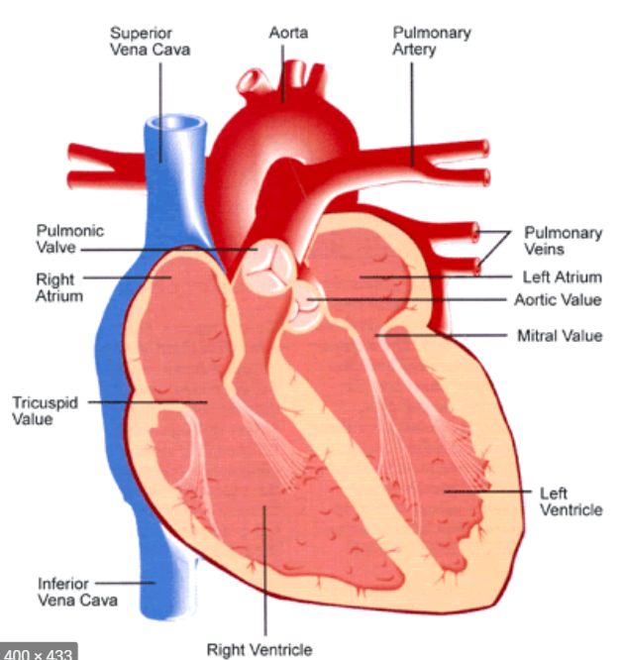
Purpose and Problem Statement
Heart Diseases are major cause of deaths.
The Left Ventricle - segmentation important for cardiac health.
Can help radiologists prioritize patients
Automatic segmentation of Left Ventricular Cavity using deep learning techniques on ACDC dataset.

Slide 3
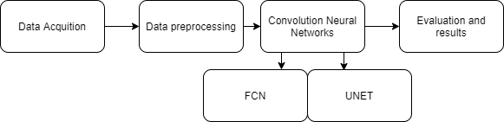
Overall Pipeline
Paper: An Exploration of 2D and 3D Deep Learning Techniques for Cardiac MR Image Segmentation [1]

Slide 4
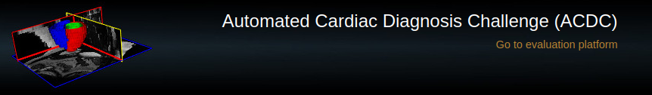
Dataset Details
150 Image Series in total:
100 available for training (80) and validation (20)
50 for testing
Dataset can be used for both:
Heart disease classification
Heart segmentation (we only segment the left ventricle)
Image format: NIFTI

Slide 5

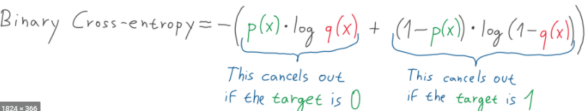
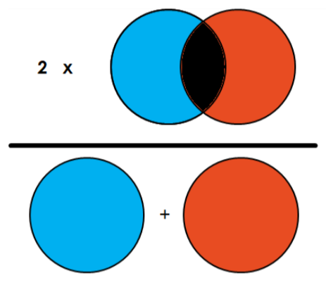
Evaluation
Dice Coefficient:
Weights the true positives more than IoU
Binary Cross-entropy:
If target is 0 and it outputs 1 then it will be severely penalized and viceversa for 1 target label.

Slide 6
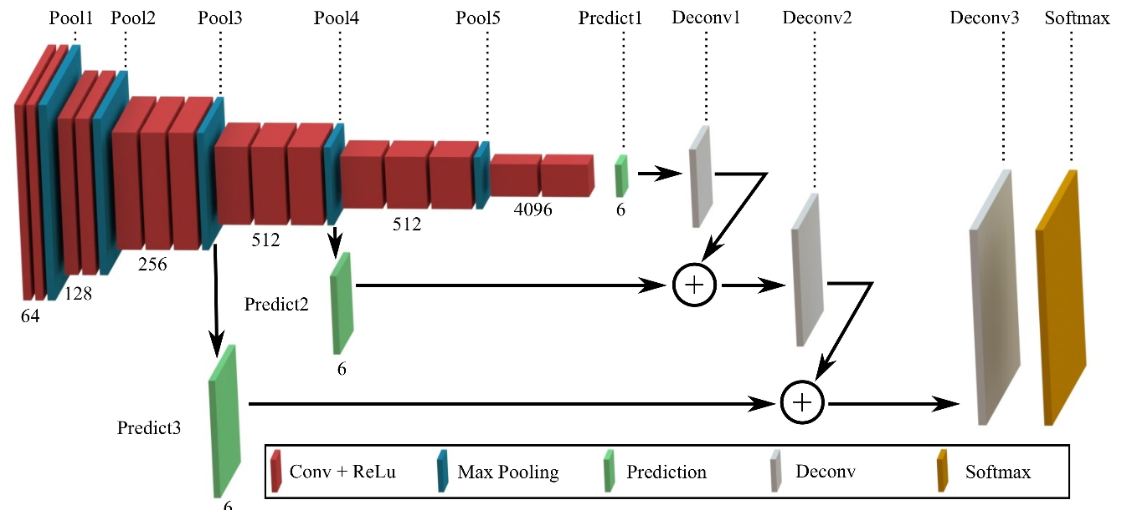
Baseline Semantic Segmentation Network
Used FCN:
Architecture consists of a VGG-16 based layer design in which 3x3 filters are used repeatedly followed by skip connections based upsampling.

Slide 7
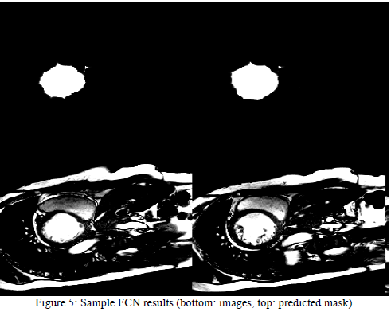
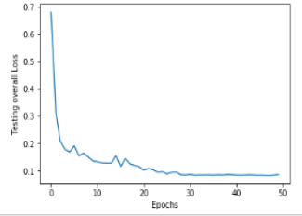
Baseline Semantic Segmentation Network
Results:
From 224x224x1 (grayscale input)
To 224x224x no_of_classes (output)
Validation dice loss: 0.142 (47th Epoch)
Learning Curve
Plotting:
The result of plot of a random image with its prediction.

Slide 8
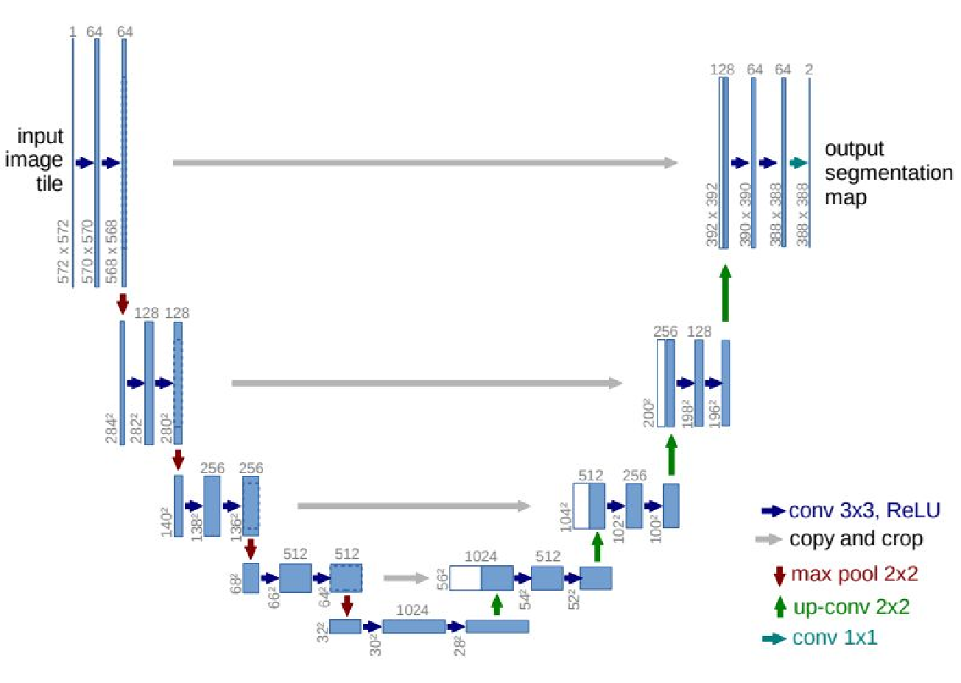
Baseline Semantic Segmentation Network
Used modified U-Net:
Contracting Path: spatial info reduced.
Expansive Path: combines features and spatial info through up-convolutions and concatenations from high resolution features from contracting path.
It’s modified as we use Transpose convolution instead of UpSampling.

Slide 9
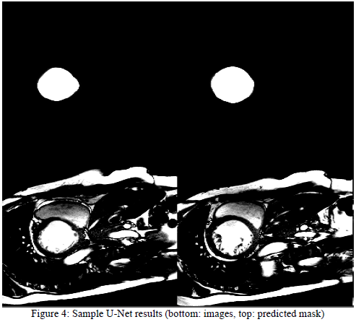
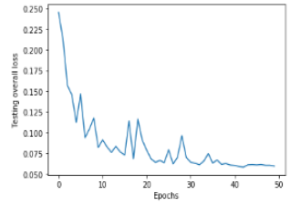
Baseline Semantic Segmentation Network
Results:
From 212x212x1 (grayscale input)
To 212x212x no_of_classes (output)
Validation dice loss: 0.105 (42nd Epoch)
Learning Curve
Plotting:
The result of plot of a random image with its prediction.
Notes:
Dice coecients of 0:950 (LV)

Slide 10
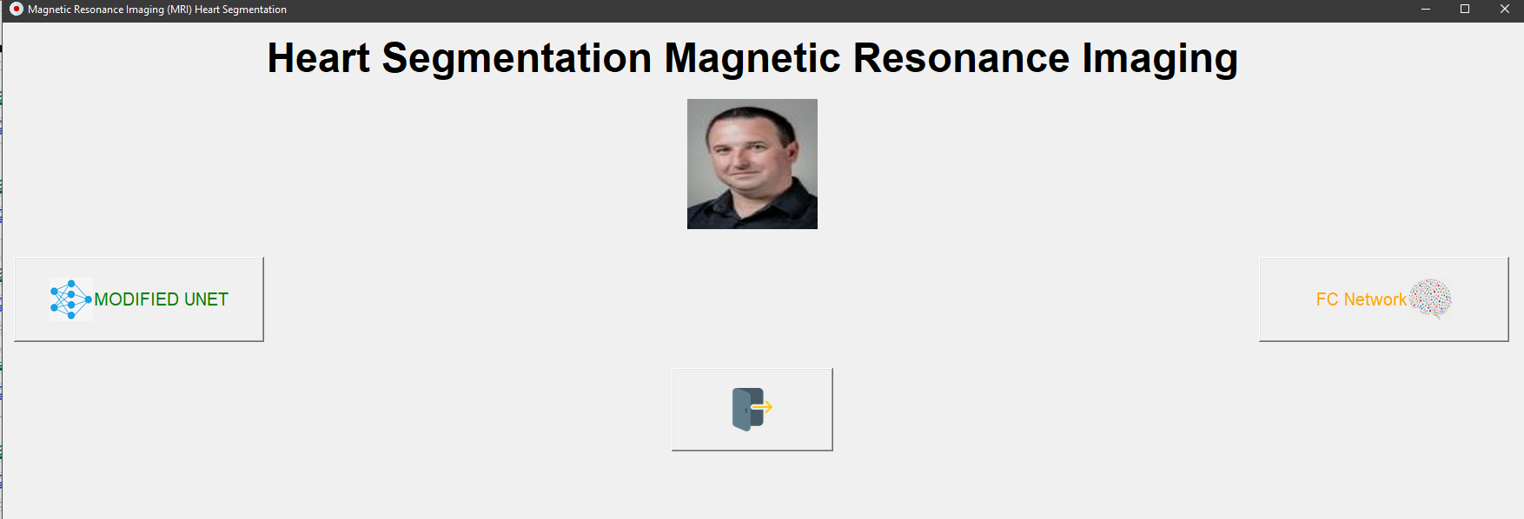
Graphical User Interface:
There is ‘READ ME.txt’ file explaining step by step process of running it

Slide 11
Future Directions:
Training for more epochs
Data augmentation
Regularization techniques (batch normalization, dropout)
3D CNN
Hardware availability

Slide 12
References:
[1]. H. Liu, H. Hu, X. Xu, and E. Song, “Automatic Left Ventricle Segmentation in Cardiac MRI Using Topological Stable-State Thresholding and Region Restricted Dynamic Programming,” Academic Radiology, vol. 19, no. 6, pp. 723–731, 2012.
[2] S. Dangi, Z. Yaniv, and C. A. Linte, “Left Ventricle Segmentation and Quantification from Cardiac Cine MR Images via Multi-task Learning,” Statistical Atlases and Computational Models of the Heart. Atrial Segmentation and LV Quantification Challenges Lecture Notes in Computer Science, pp. 21–31, 2019.
[3] J. Margeta, E. Geremia, A. Criminisi, N. Ayache, Layered spatio-temporal forests for left ventricle segmentation from 4D cardiac MRI data, LNCS, 7085, pp. 109-119,(2011)
[4] T. A. Ngo, G. Carneiro, Left ventricle segmentation from cardiac MRI combining level set methods with deep belief networks, 2013 20th IEEE International Conference onImage Processing (ICIP), pp. 695-699, (2013) , Thresholding based methods (u Y, Radau P, Connelly K, et al. Segmentation of left ventricle in cardiaccine MRI: An automatic image-driven method. Functional Imaging and Modeling of the Heart 2009; 5528:339–347.
[5] C. Baumgartner, L. M. Koch, M. Pollefeys, and E. Konukoglu, “An Exploration of 2D and 3D Deep Learning Techniques for Cardiac MR Image Segmentation,” in Proc. STACOM-MICCAI, LNCS, volume 10663, 2017,pp. 111–119.
[6] Ronneberger, O., Fischer, P., Brox, T.: U-Net: Convolutional Networks for Biomed-ical Image Segmentation. In: MICCAI. pp. 234–241 (2015)
[7] Long, J., Shelhamer, E., Darrell, T.: Fully Convolutional Networks for SemanticSegmentation. In: CVPR. pp. 343 –3440 (2015)
[8] Bernard, “Databases,” ACDC Challenge. [Online]. Available: https://www.creatis.insa-lyon.fr/Challenge/acdc/databases.html. [Accessed: 17-Dec-2020].
[9] O. Bernard, A. Lalande, C. Zotti, F. Cervenansky, X. Yang, P.-A. Heng, I. Cetin, K. Lekadir, O. Camara, M. A. G. Ballester, G. Sanroma, S. Napel, S. Petersen, G. Tziritas, E. Grinias, M. Khened, V. A. Kollerathu, G. Krishnamurthi, M.-M. Rohe, X. Pennec, M. Sermesant, F. Isensee, P. Jager, K. H. Maier-Hein, P. M. Full, I. Wolf, S. Engelhardt, C. F. Baumgartner, L. M. Koch, J. M. Wolterink, I. Isgum, Y. Jang, Y. Hong, J. Patravali, S. Jain, O. Humbert, and P.-M. Jodoin, “Deep Learning Techniques for Automatic MRI Cardiac Multi-Structures Segmentation and Diagnosis: Is the Problem Solved?,” IEEE Transactions on Medical Imaging, vol. 37, no. 11, pp. 2514–2525, 2018.

Slide 13
Thank you for the opportunity professor !!
We learnt a lot :)
Any Questions?

